Slide 1
Project 4:
Trisia Baltazar
Justin Kellerman
Maria Martinez
Ryan Smith
Notes:
After introducing ourselves, give a quick summary about the case (i.e. – Today we are here to present the evidence found against Perry Winkler, a suspected drug dealer. As we go over our findings, we will also provide our methodology and conclude with any additional evidence we believe may assit the LMPD with this investigation.

Slide 2
Identification
Tools Used:
Registry Explorer
RegRipper
Evidence:
Computer name is: “PERRYWINKLER-PC”
SOFTWARE hive confirmed Perry as the registered owner.
SAM hive confirmed Perry as the administrator
Notes:
We were given an already imaged hard drive to find data that could help discover Perry Winkler’s whereabouts. The first step we took was to confirm that this hard drive could be associated with Perry Winkler in any way.
Using [tools listed] we were able to confirm that the user and owner of the computer is Perry Winkler. [Evidence]. This is the only non-built in account on the system. RegRipper confirmed the account creation date.

Slide 3
Collected Evidence
Tools Used:
Autopsy
FTKImager
LeCMD
Evidence:
Images
Applications
Documents
Web History
Notes:
Now that this is confirmed to be related to the suspect, we started to search and collect data that may confirm or associate Perry with drug dealing and other illegal activities. Within Perry’s account we found images, applications, documents, and web history that confirm his involvement.

Slide 4
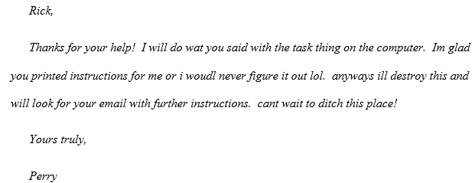
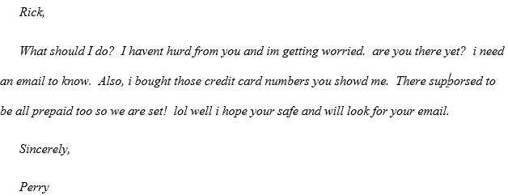
Directory: root/users/Perry/Documents (Letter 1 & 3)
root/Recycle .Bin (Letter 2)
Letter 2
2/21/2016
Letter 3
2/27/2016
Notes:
So, starting with images, there is immediate confirmation of drugs/drug dealing activity.

Slide 5
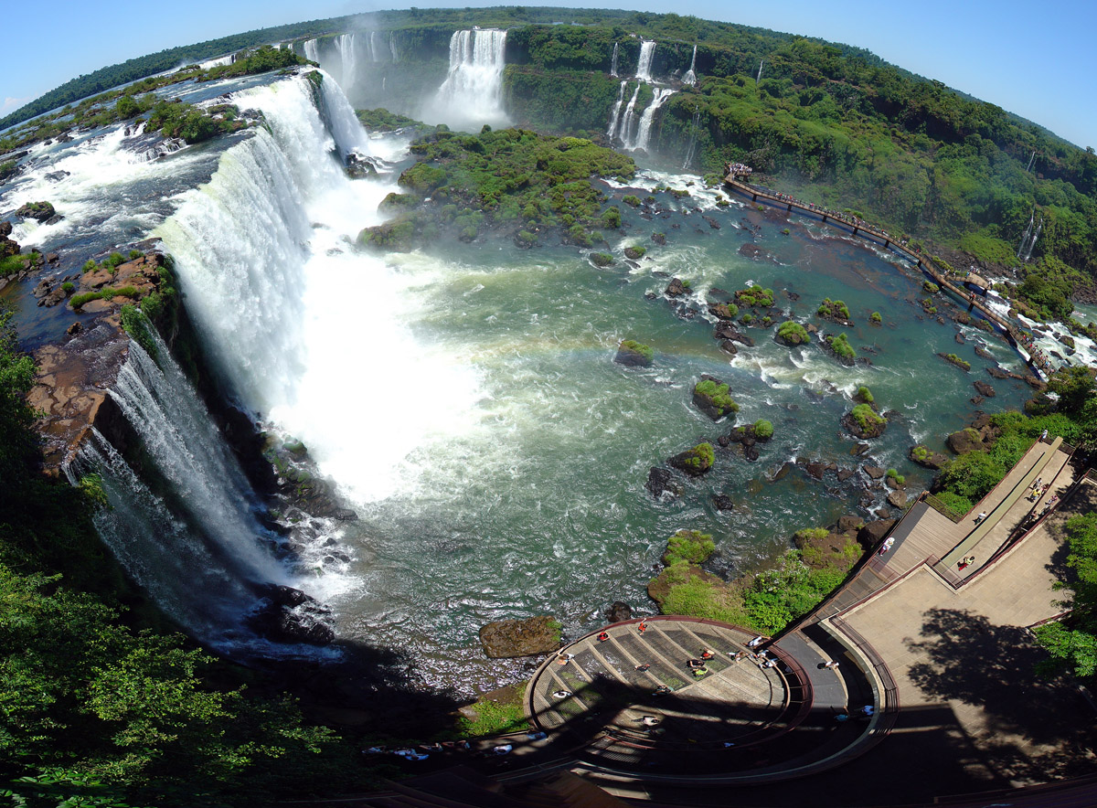
Directory: root/users/Perry/Documents/nice
Iguazu-falls.jpg
2/27/2016
Possible Destination: South America
The falls is located in Missiones, Provence, Argentina

Slide 6
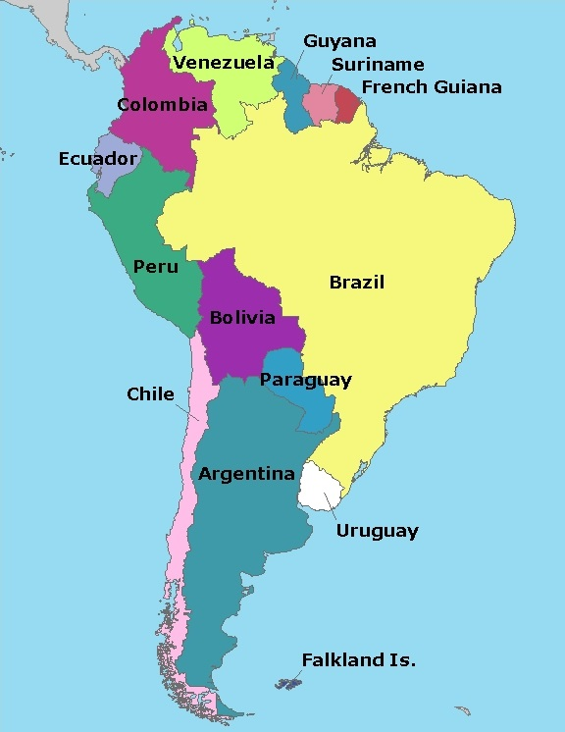
Directory: unallocated space/00000048/01494406
Possible Destination: South America

Slide 7
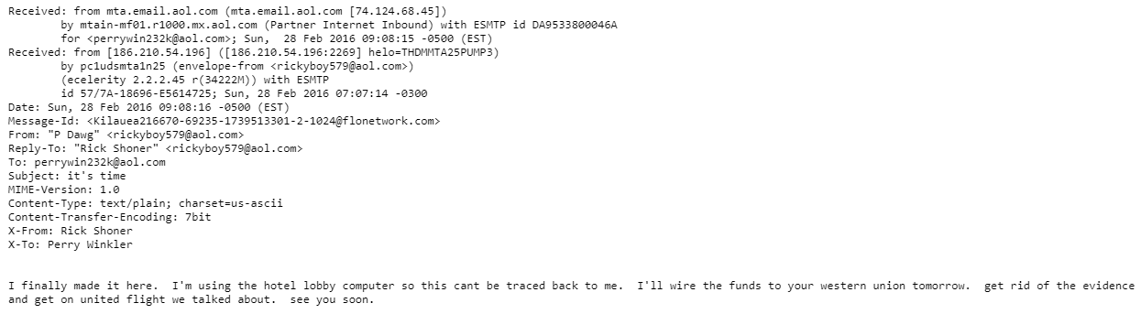
Directory: unallocated/00000048
Email from Rick Shoner
2/28/2016
Notes:
Excel spread is literal book keeping of deals/transactions

Slide 8
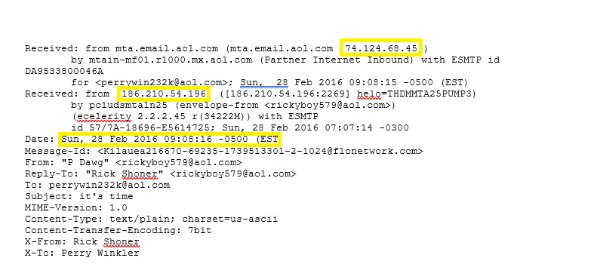
Directory: unallocated/00000048
Notes:
Excel spread is literal book keeping of deals/transactions

Slide 9
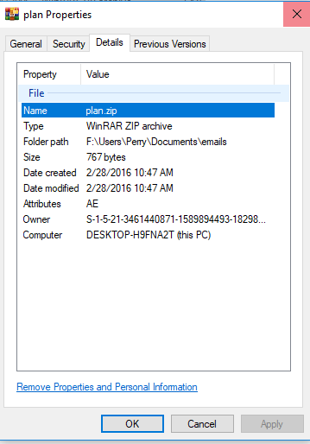
Directory:root/Users/Perry/Documents/emails
Plan.zip
2/28/2016
Notes:
Excel spread is literal book keeping of deals/transactions

Slide 10
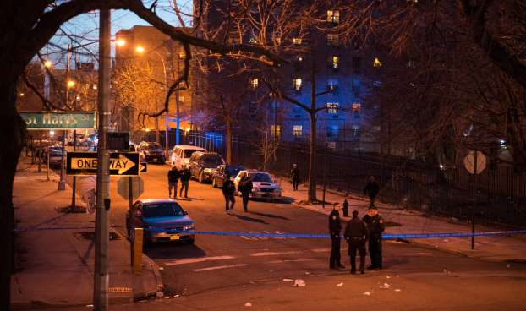



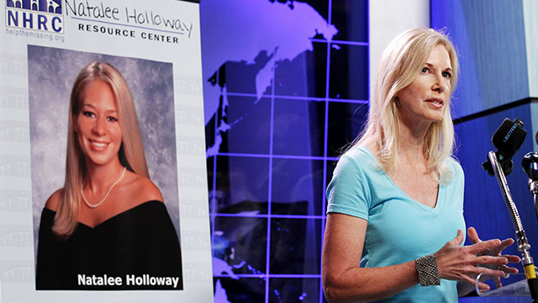
Murdered woman whose killer was convicted w/ the help of digital forensics

Slide 11
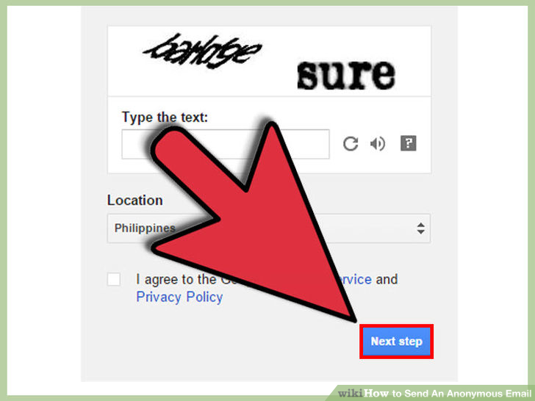
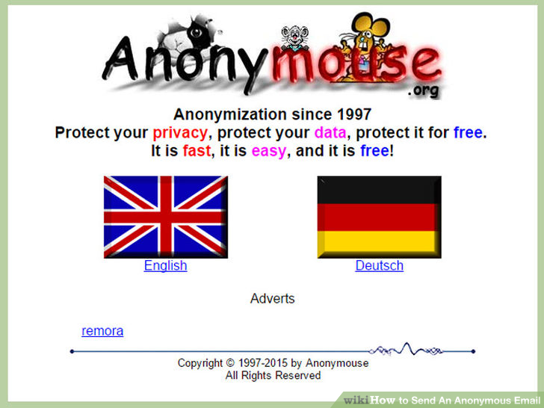
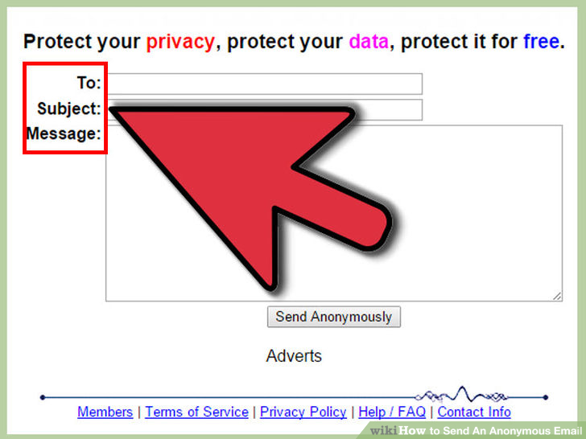
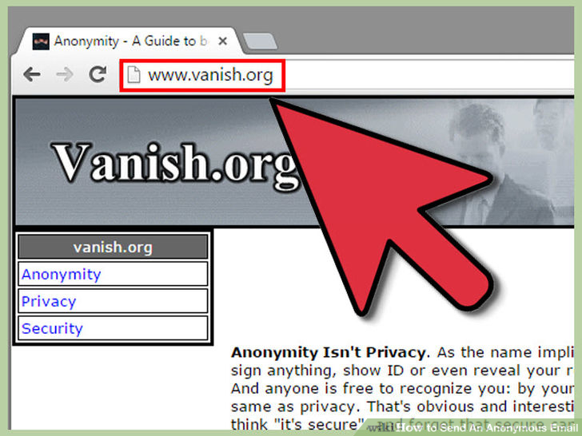
Used to for privacy and enhance privacy online.
Learn to give sites you visit the appearance that you reside in a foreign country.
Anonymouse: used to send email messages anonymously. Its online browser-based anonymouse ip service. There is a paid service and free.

Slide 12
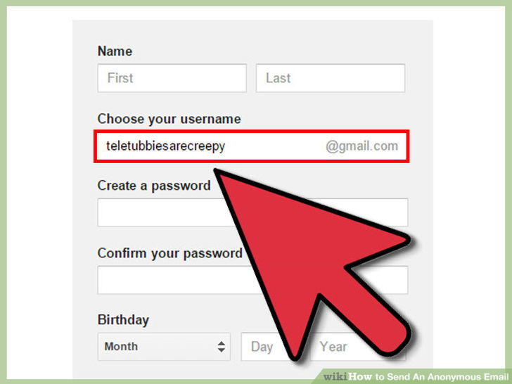
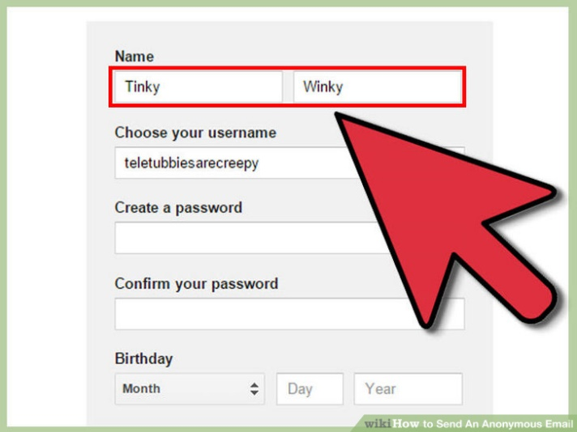

Slide 13
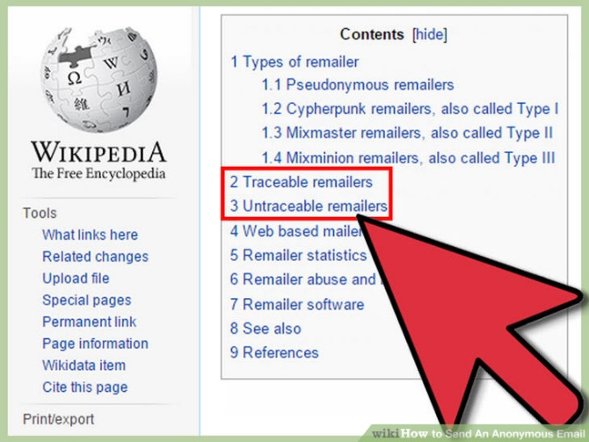
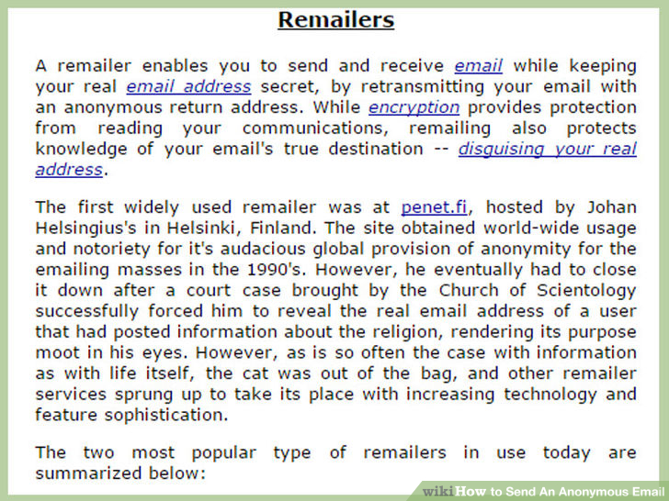
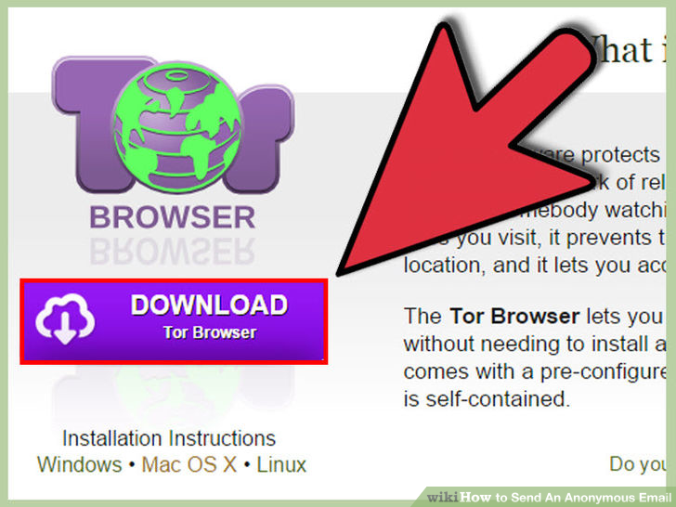
1/15/2016 21:20 Used the Tor Brower

Slide 14
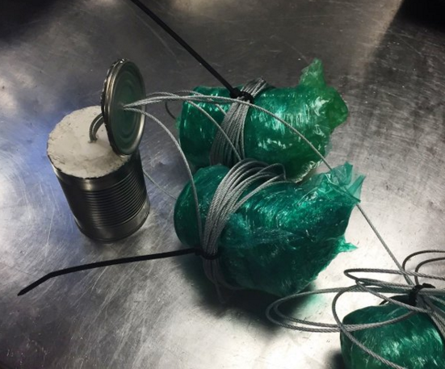
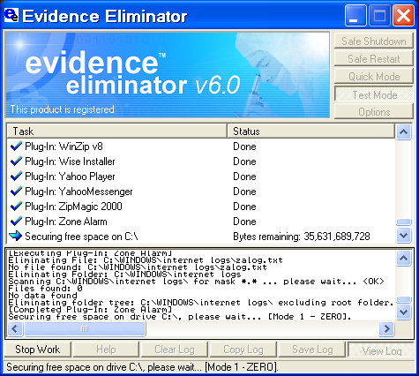
Scanners being tested for carry-on luggage could allow travelers to keep liquids in their bags
An item with an organic mass and protruding wires triggered an alarm resulting in a bag search at New York Kennedy (JFK). The suspicious item ended up being what the traveler described as abstract art. DIY art and electronic projects can look a lot like explosives. Please keep this in mind when packing your bags and possibly consider shipping the item instead of packing it

